Slide 1
Netflix eda & recommendation
Saad Alkhathlan – Final Project – SDAIA Bootcamp

Slide 2
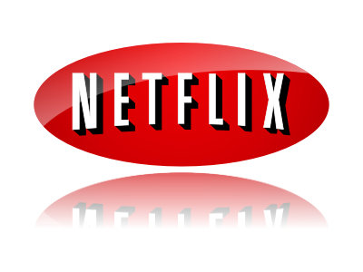
Introduction
Netflix is a streaming service that allows its members to watch TV shows & Movies on internet-connected devices, The goal of this project is to build an EDA or a storytelling through data with different graphs and visuals alongside a recommendation system that aims to benefit viewers and producers.

Slide 3

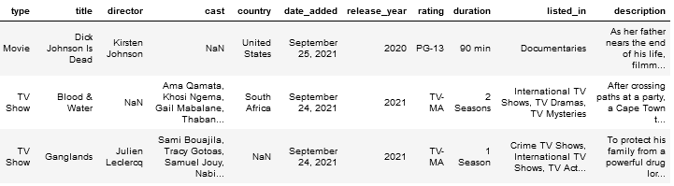
Data sources
Listings of Movies & TV shows on Netflix, January 2008- September 2021, Kaggle.
IMDb Movies
IMDb Ratings
dataset contains 8807 data points with 12 features

Slide 4
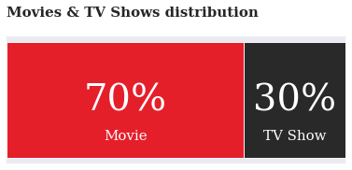

CONTENT

Slide 5
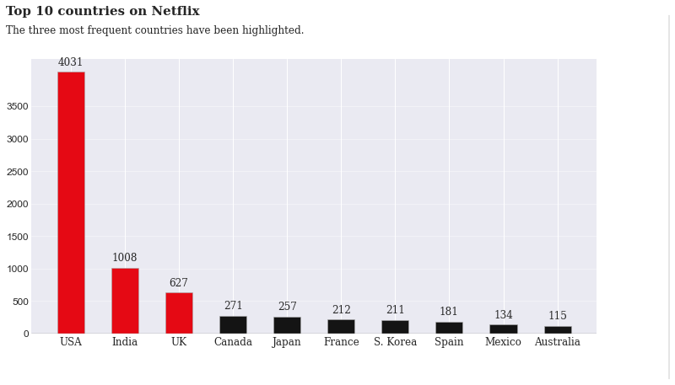
CONTENT BY COUNTRY

Slide 6
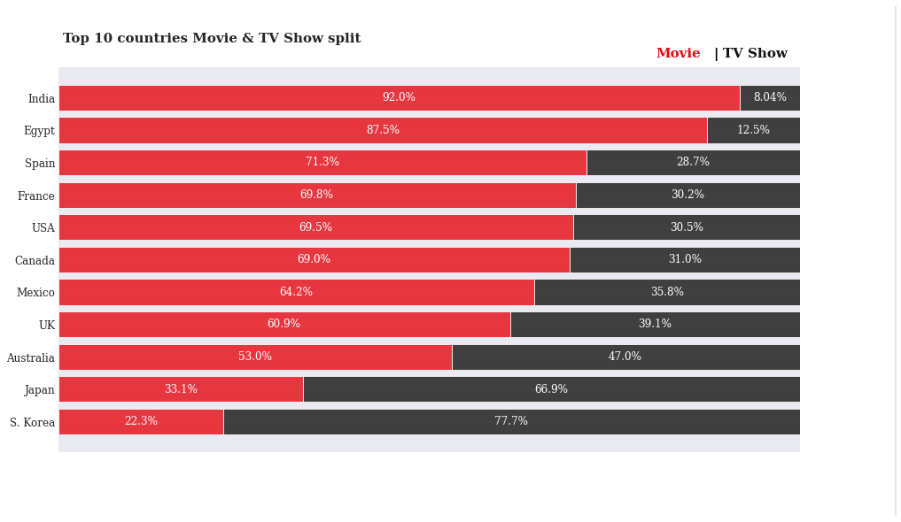
TV SHOWS & MOVIES VARIES BY COUNTRIEES

Slide 7
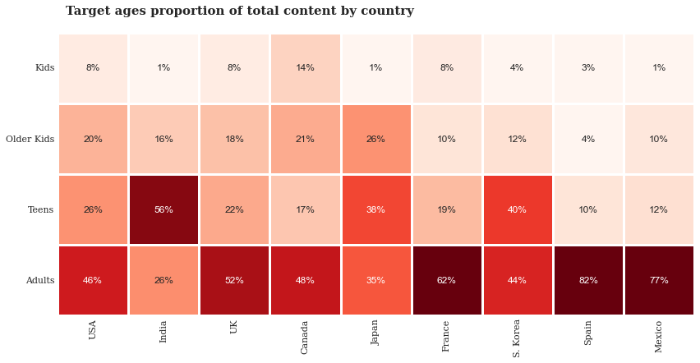

Slide 8
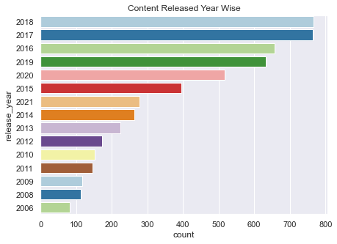

Slide 9
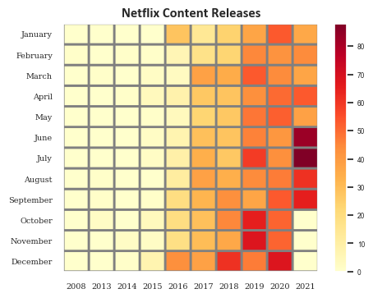

what’s the best month for a producer to release some content on Netflix?

Slide 10
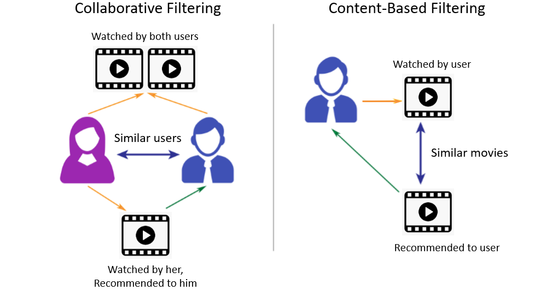
Content-Based Recommendation System

Slide 11
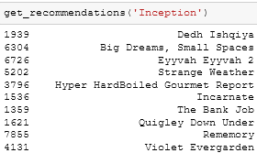
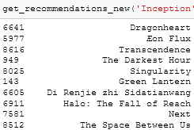
Content-Based filtering
Based on the Plot only
Based on multiple metrics

Slide 12
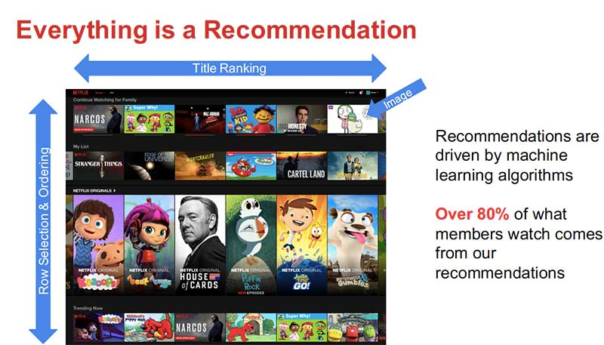
conclusion

Slide 13
Thank you

